Slide 1
COMP SCI 3007/7059/7659 Artificial Intelligence Understanding Neural Networks Dr Zhibin Liao
Faculty of SET / School of Computer and Mathematical Sciences

Slide 2

Acknowledgement of Country
We acknowledge and pay our respects to the Kaurna people, the traditional custodians whose ancestral lands we gather on.
We acknowledge the deep feelings of attachment and relationship of the Kaurna people to the country and we respect and value their past, present and ongoing connection to the land and cultural beliefs.

Slide 3
Outline
How to train a simple neural network
Visually understanding the neural network (in different ways)

Slide 4
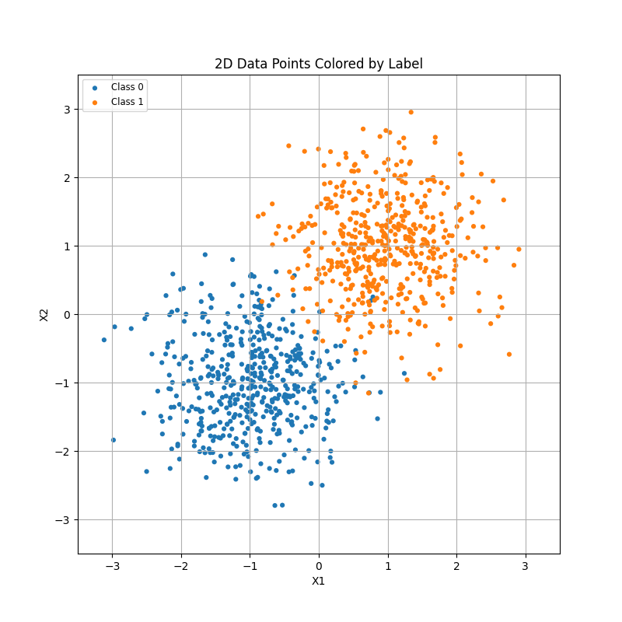
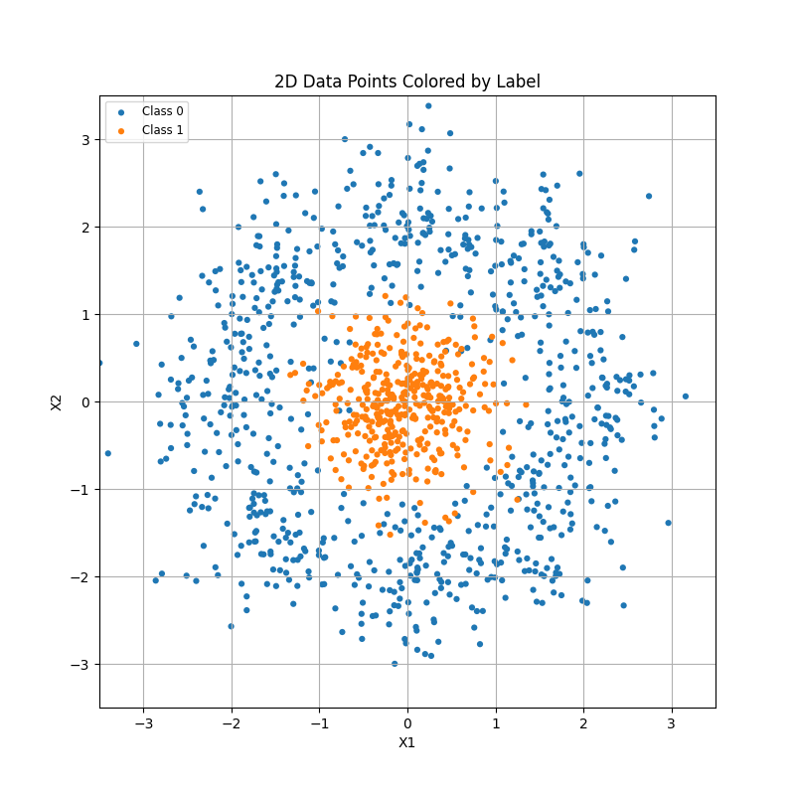
Datasets
1000 points (500:500 pos vs neg)
1200 points (400 pos 800 neg)

Slide 5
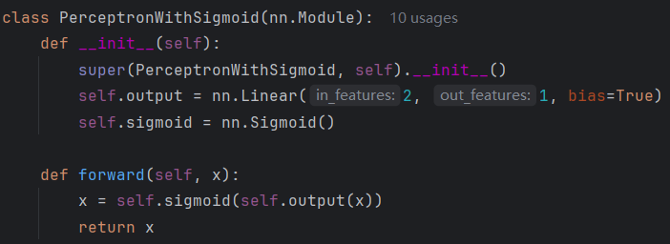
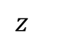
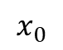
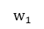
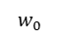
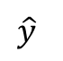
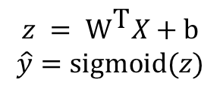
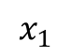
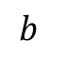
Model - Perceptron with 1 output node
$$b_{}$$
$$x_{0}$$
$$w_{0}$$
$$z_{}$$
sigmoid
$$\hat{y}$$
$${\text{w}}_{1}$$
$$x_{1}$$
$$z = {\text{W}}^{\text{T}}X\text{ + }\text{b}$$
$$\hat{y}=sigmoid(z)$$

Slide 6
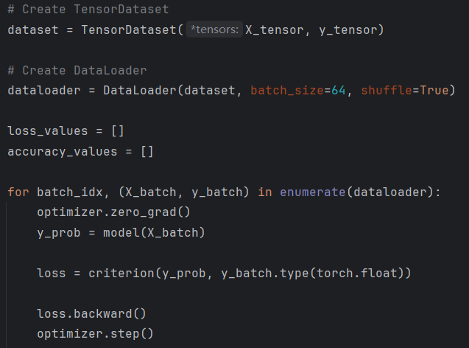
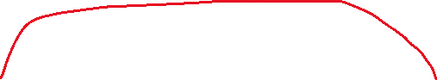
Solve the problem (define your training loop)

Slide 7
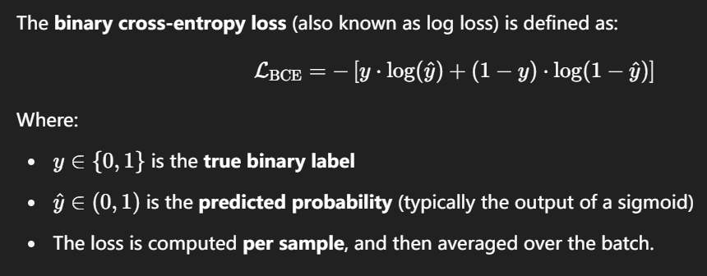
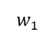
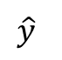
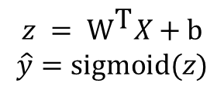
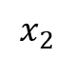
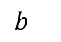
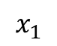
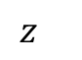
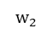
Loss function (Criterion) – Binary Cross Entropy
$$b_{}$$
$$x_{1}$$
$$w_{1}$$
$$z_{}$$
sigmoid
$$\hat{y}$$
$${\text{w}}_{2}$$
$$x_{2}$$
$$z = {\text{W}}^{\text{T}}X\text{ + }\text{b}$$
$$\hat{y}=sigmoid(z)$$

Slide 8
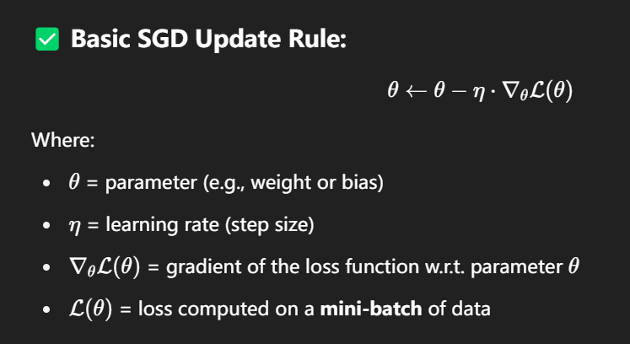
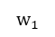
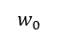
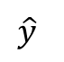
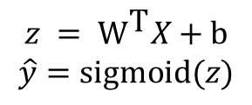
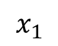
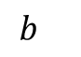
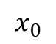
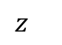
Optimizer - SGD
$$b_{}$$
$$x_{0}$$
$$w_{0}$$
$$z_{}$$
sigmoid
$$\hat{y}$$
$${\text{w}}_{1}$$
$$x_{1}$$
lr = {0.001, 0.01, 0.1}
batch_size = 64
num_epoch = 20
$$z = {\text{W}}^{\text{T}}X\text{ + }\text{b}$$
$$\hat{y}=sigmoid(z)$$

Slide 9
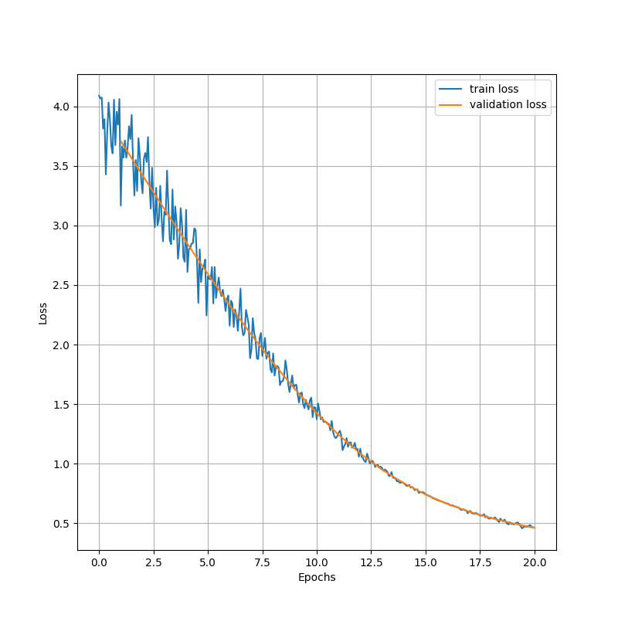
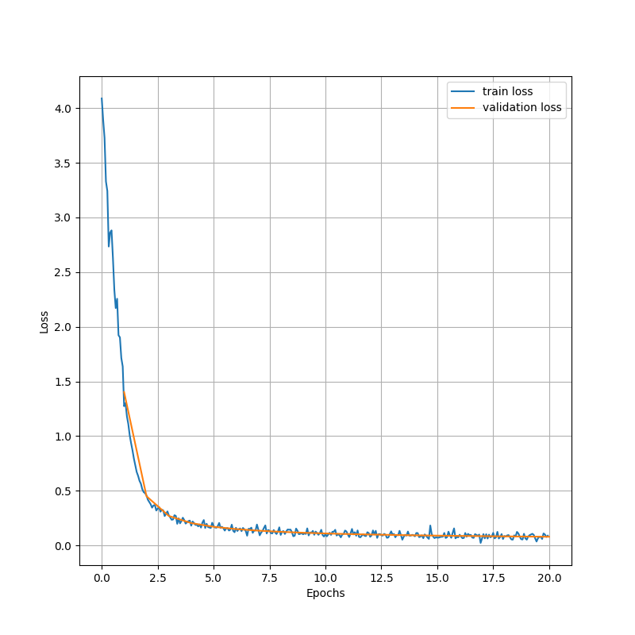
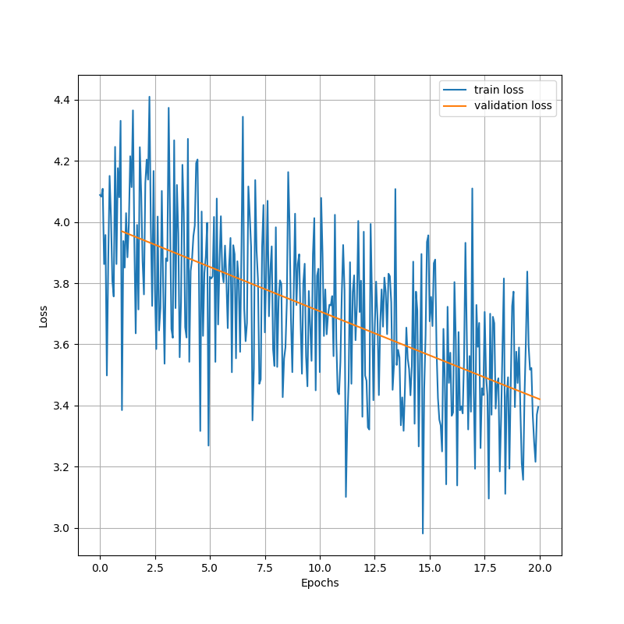
Learning rate from 0.001 to 0.1, loss change
0.001
0.01
0.1

Slide 10
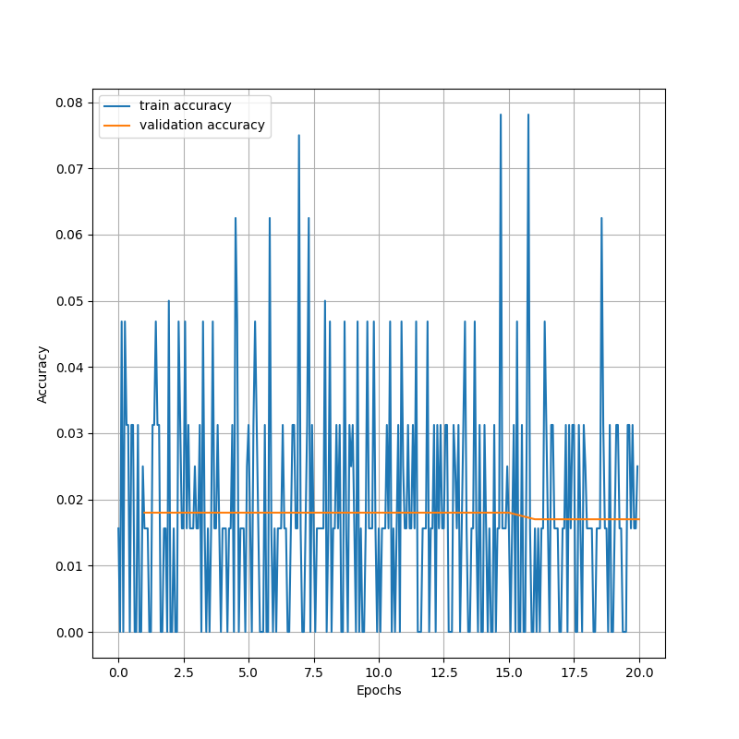
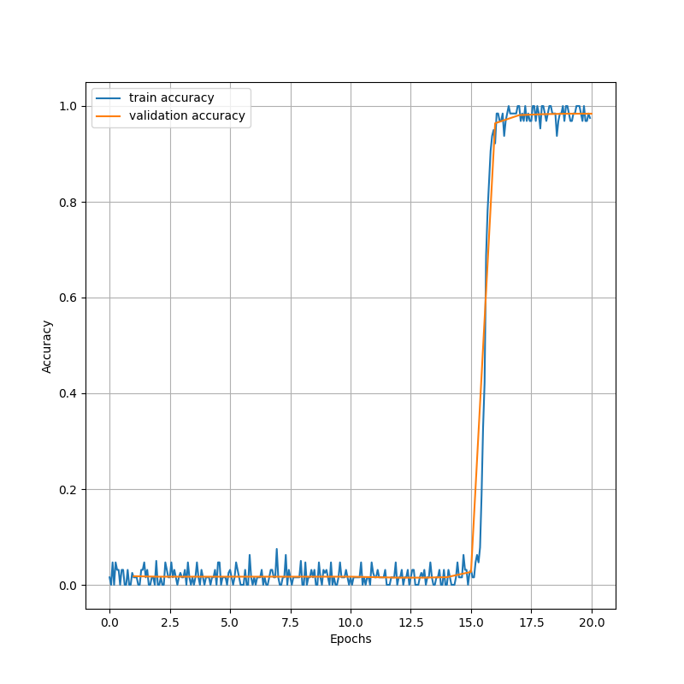
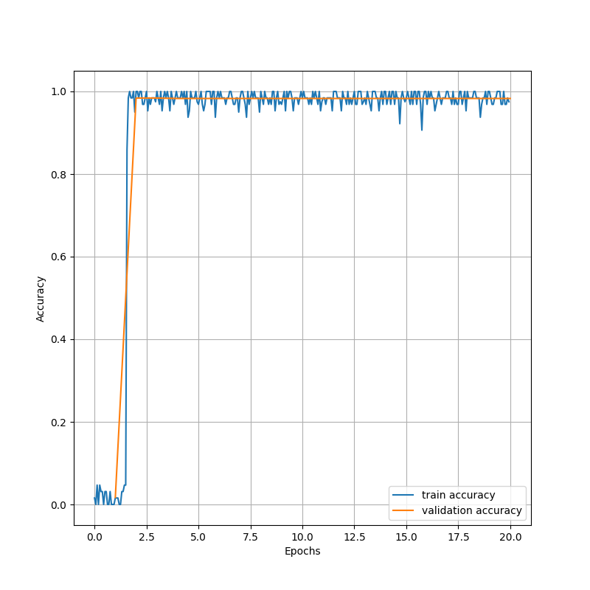
Learning rate from 0.001 to 0.1, accuracy change
0.001
0.01
0.1

Slide 11
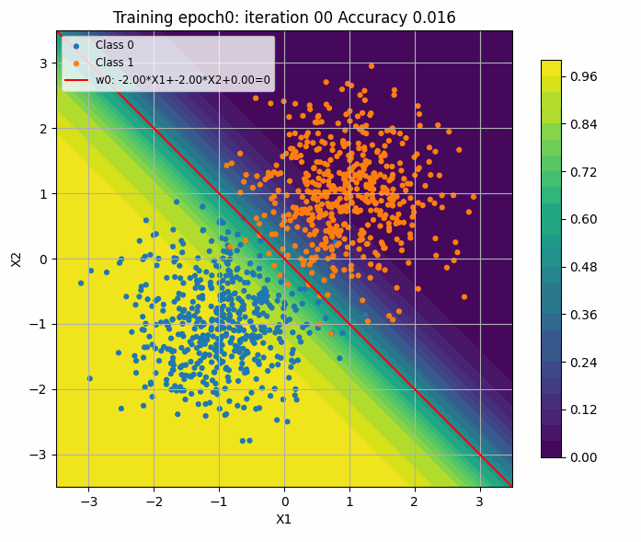
Visualising the weights (No bias) lr 0.001

Slide 12
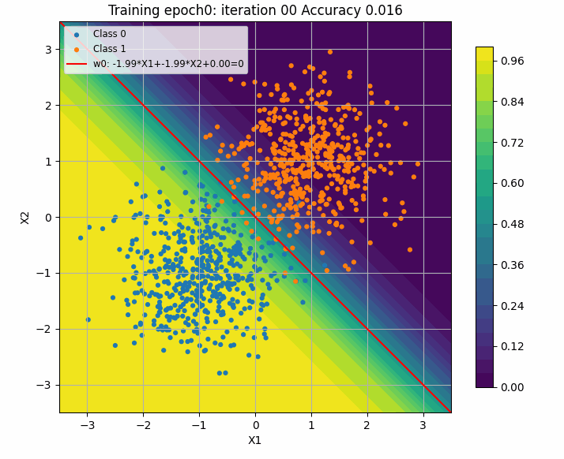
Visualising the weights (No bias) lr 0.01

Slide 13

Visualising the weights (No bias) lr 0.1

Slide 14
Visualising the weights (No bias) lr 0.1

Slide 15
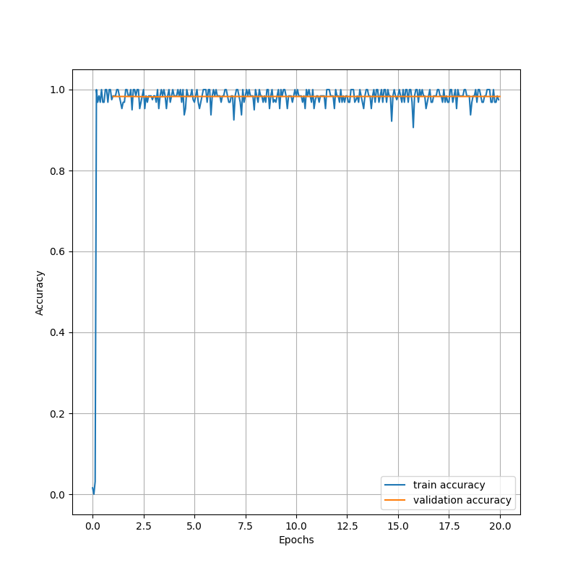

Visualising the weights (No bias) lr 1

Slide 16
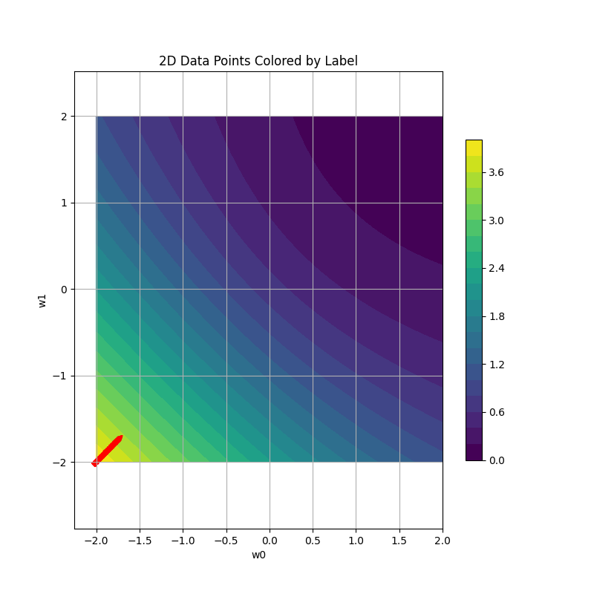
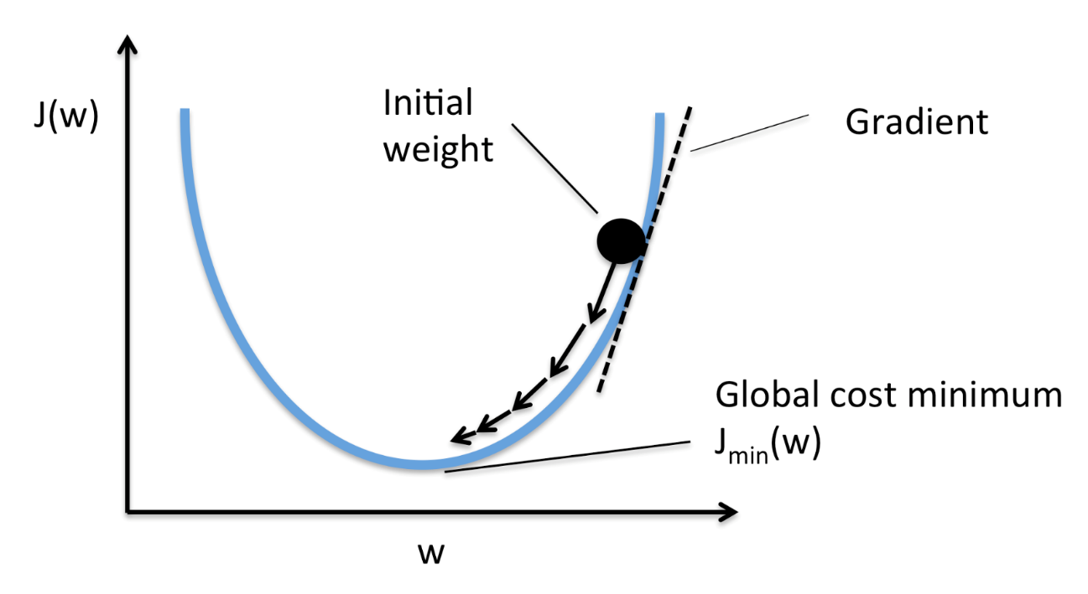
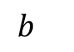
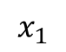
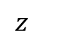
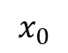
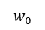
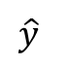
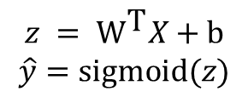
Visualising the weight space (no bias)
$$b_{}$$
$$x_{0}$$
$$w_{0}$$
$$z_{}$$
sigmoid
$$\hat{y}$$
$${\text{w}}_{1}$$
$$x_{1}$$
$$z = {\text{W}}^{\text{T}}X\text{ + }\text{b}$$
$$\hat{y}=sigmoid(z)$$

Slide 17
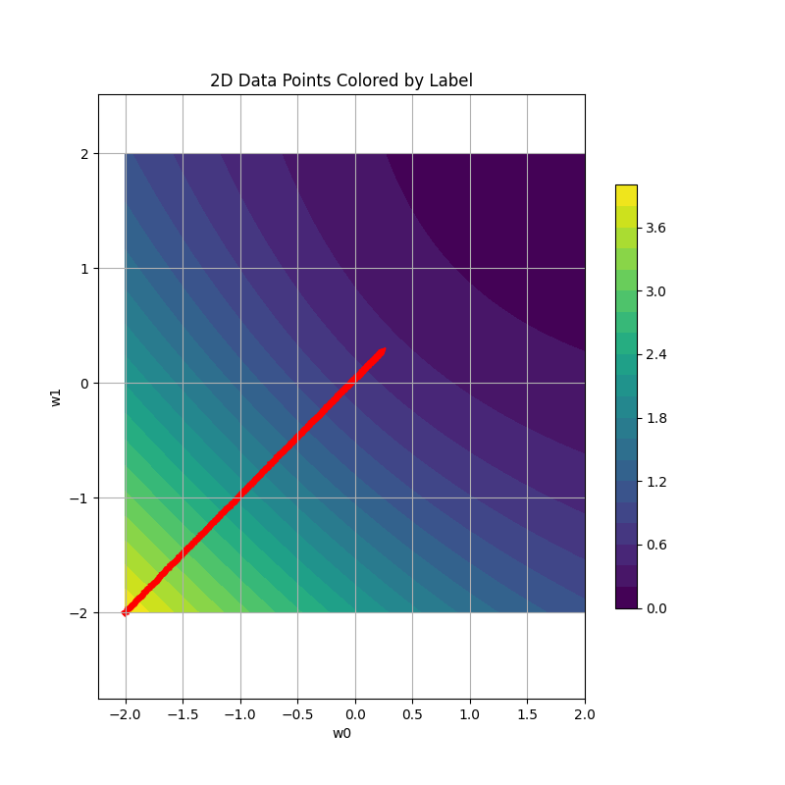

Visualising the weights (No bias) – in weight space
0.001
0.01
0.1

Slide 18








How about lr=1 then
$$b_{}$$
$$x_{1}$$
$$w_{1}$$
$$z_{}$$
sigmoid
$$\hat{y}$$
$${\text{w}}_{2}$$
$$x_{2}$$
$$z = {\text{W}}^{\text{T}}X\text{ + }\text{b}$$
$$\hat{y}=sigmoid(z)$$

Slide 19







Nonlinear problem
$$b_{}$$
$$x_{0}$$
$$w_{0}$$
$$z_{}$$
sigmoid
$$\hat{y}$$
$${\text{w}}_{1}$$
$$x_{1}$$
$$z = {\text{W}}^{\text{T}}X\text{ + }\text{b}$$
$$\hat{y}=sigmoid(z)$$

Slide 20



Learning rate from 0.001 to 0.1, loss change
0.001
0.01
0.1

Slide 21



Learning rate from 0.001 to 0.1, accuracy change
0.001
0.01
0.1

Slide 22



Learning rate from 0.001 to 0.1, weight space travel change
0.001
0.01
0.1

Slide 23

Learning rate 0.1

Slide 24


How about lr=1? We are on to something!

Slide 25


How about lr=5? We did it!

Slide 26
What minimum network structure can solve this?
lr=0.1 FTW?

Slide 27









What minimum network structure can solve this?
$$h_{0}$$
$$x_{0}$$
$$h_{1}$$
$$z_{}$$
sigmoid
$$\hat{y}$$
$$x_{1}$$
$$h_{2}$$
$$h = {\text{W}}^{\text{T}}X\text{ + }\text{b}$$
$$z = {\text{W}}^{\text{T}}\text{h}\text{ + }\text{b}$$
$$\hat{y}=sigmoid(z)$$

Slide 28


Loss and Accuracy
Loss
Accuracy

Slide 29


Longer training? Sure, 50 epochs
Loss
Accuracy

Slide 30

How does the training look like (30 epochs)?

Slide 31
























Softmax network -> Sigmoid network (binary classification)
$$b_{1}$$
$${b′}_{}$$
$$x_{1}$$
$$x_{1}$$
$${\text{w}}_{11}$$
$${\text{w}}_{12}$$
$$z_{1}$$
$$y_{1}$$
$${w′}_{1}$$
$$x_{2}$$
$${\text{w}}_{21}$$
softmax
$$x_{2}$$
$${z′}_{}$$
sigmoid
$${y′}_{}$$
$${\text{w}}_{22}$$
$$z_{2}$$
$$y_{2}$$
$${\text{w}\text{′}}_{2}$$
$${\text{w}}_{31}$$
$$x_{3}$$
$${\text{w}}_{32}$$
$$x_{3}$$
$${w′}_{3}$$
$$z^{′}= {\text{W}\text{′}}^{\text{T}}X\text{ + }\text{b}\text{′}$$
$$y′=sigmoid(z^{′})$$
$$b_{2}$$

Slide 32


Softmax network on dataset 1
$$b_{1}$$
$$x_{1}$$
$${\text{w}}_{11}$$
$${\text{w}}_{12}$$
$$z_{1}$$
$$y_{1}$$
$$x_{2}$$
$${\text{w}}_{21}$$
softmax
$${\text{w}}_{22}$$
$$z_{2}$$
$$y_{2}$$
$${\text{w}}_{31}$$
$$x_{3}$$
$${\text{w}}_{32}$$
$$b_{2}$$
Loss
Accuracy

Slide 33


Softmax to Sigmoid network
sigmoid
softmax

Slide 34
Conclusion
Neural networks are usually very large and hard to understand.
We don’t understand because we cannot visualize hyper-dimensional space.
Project to lower dimensional space? Yes, t-SNE, PCA, etc.
Try to understand your loss and accuracy figures.
If you stuck, imagining your problem in a 2D analogy can help.

